Slide 1
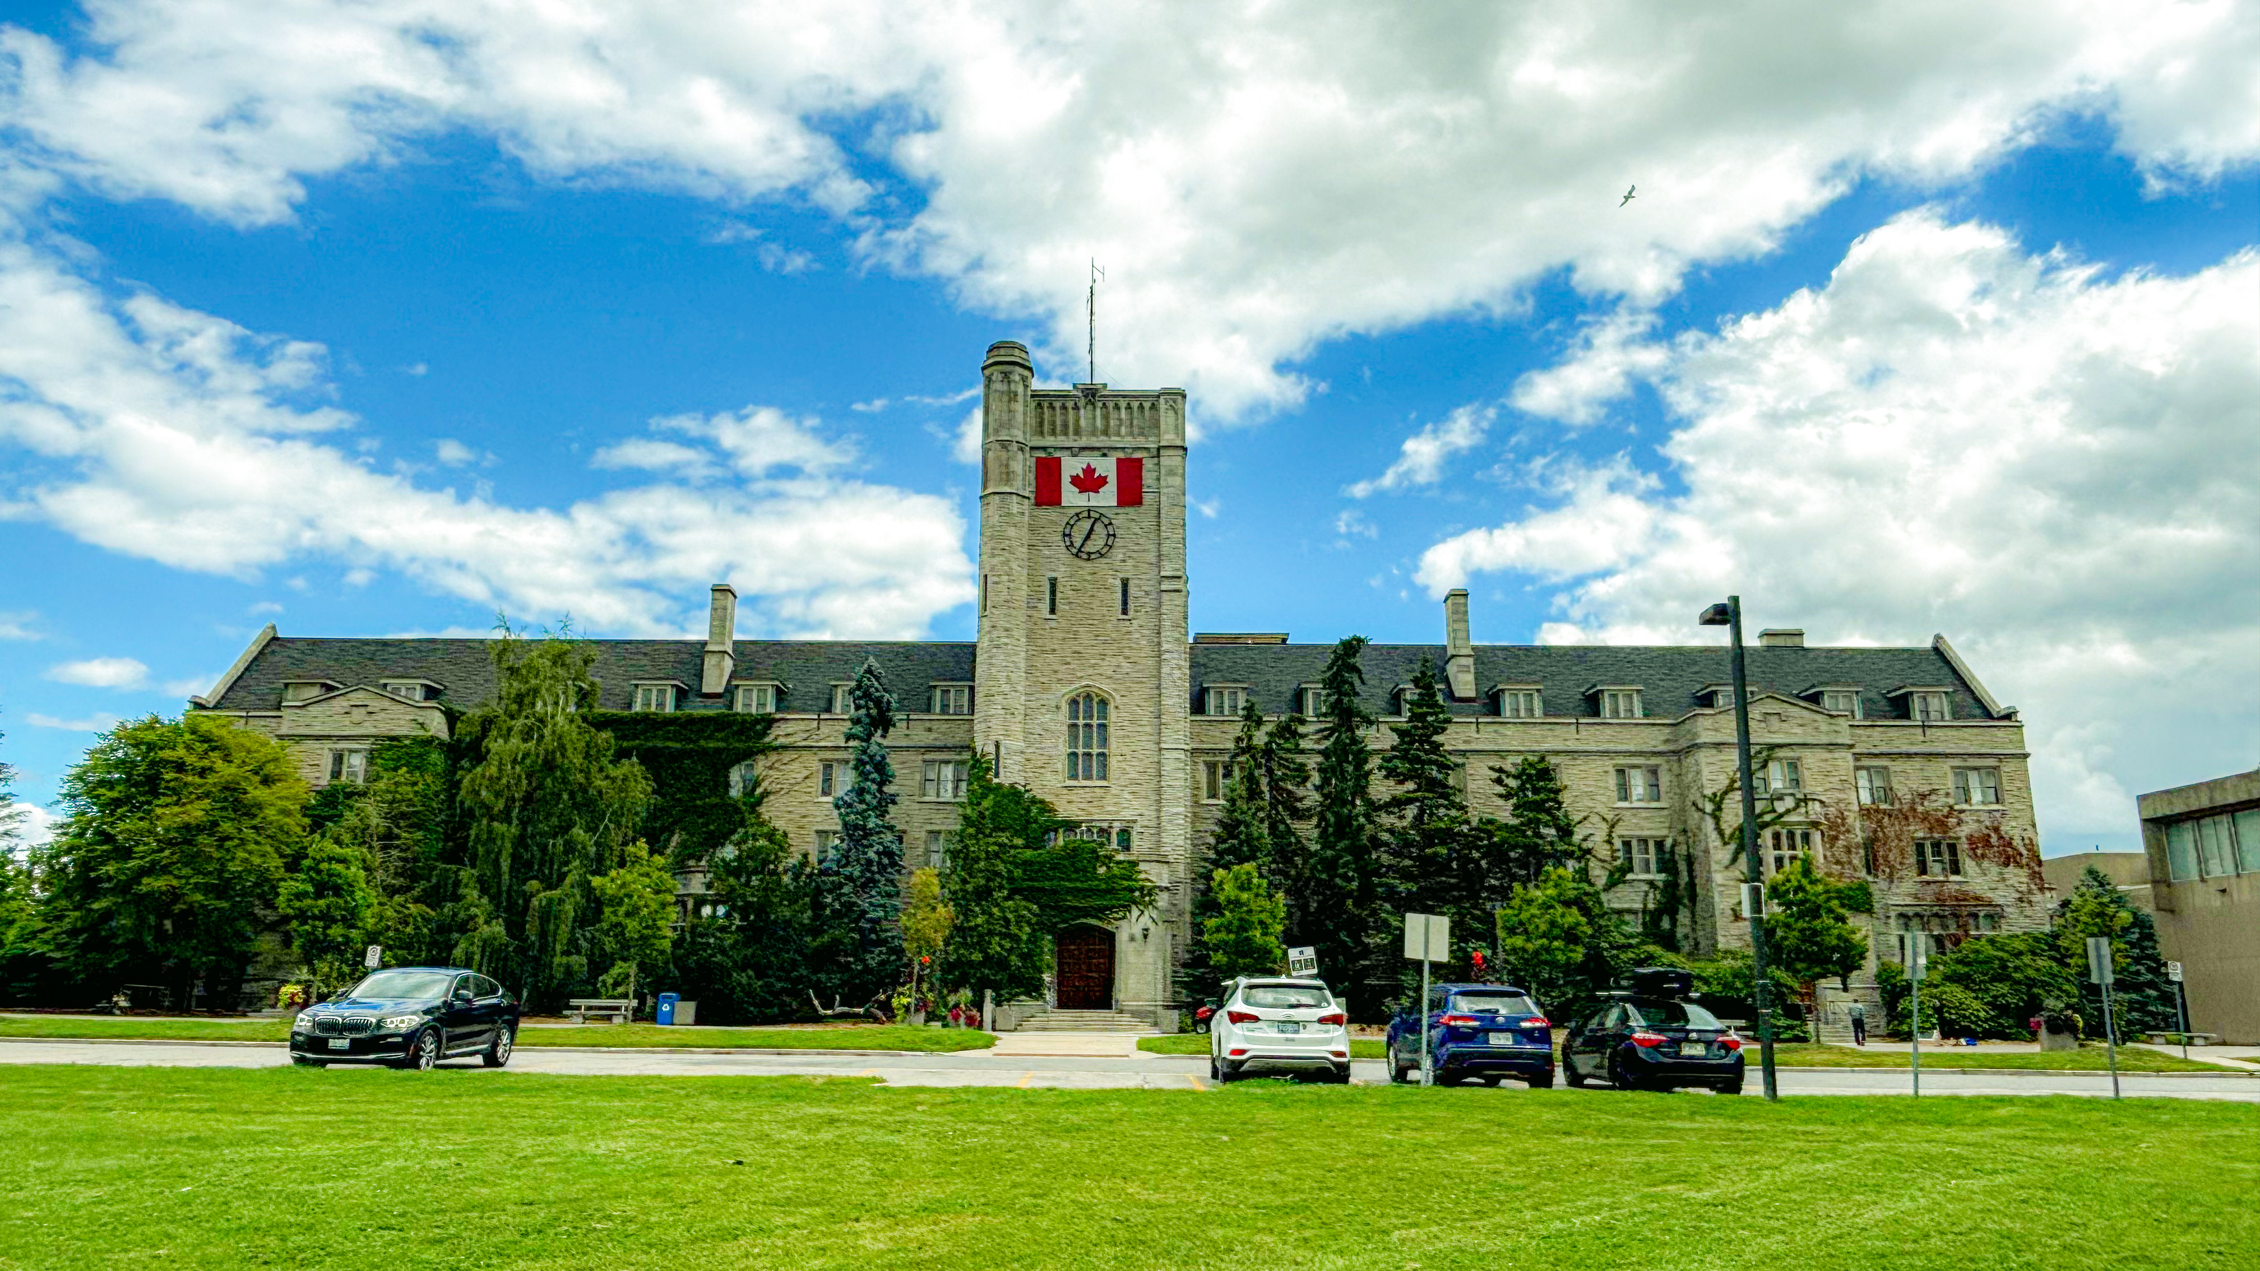

Your own logo
Americas Regional Meeting of the Polymer Processing Society
Presenter Last Name, First Name¹; Author First Name, Last Name²
¹First Affiliation; ²Second Affiliation
Your Poster Title
Please remove these instructions
Maximum Dimension is 36 inch length x 48 inch width
Please leave the PPS and conference logo
Please print the poster in advance as we will have no facilities to print these on the day

